Slide 1
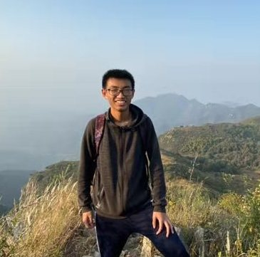
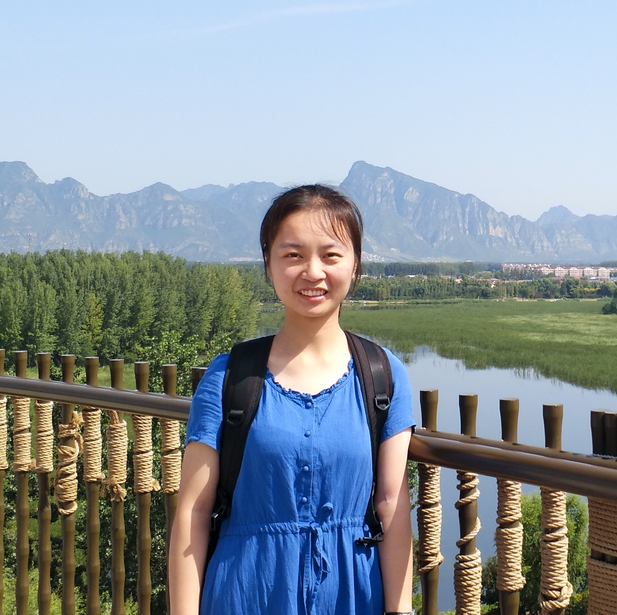
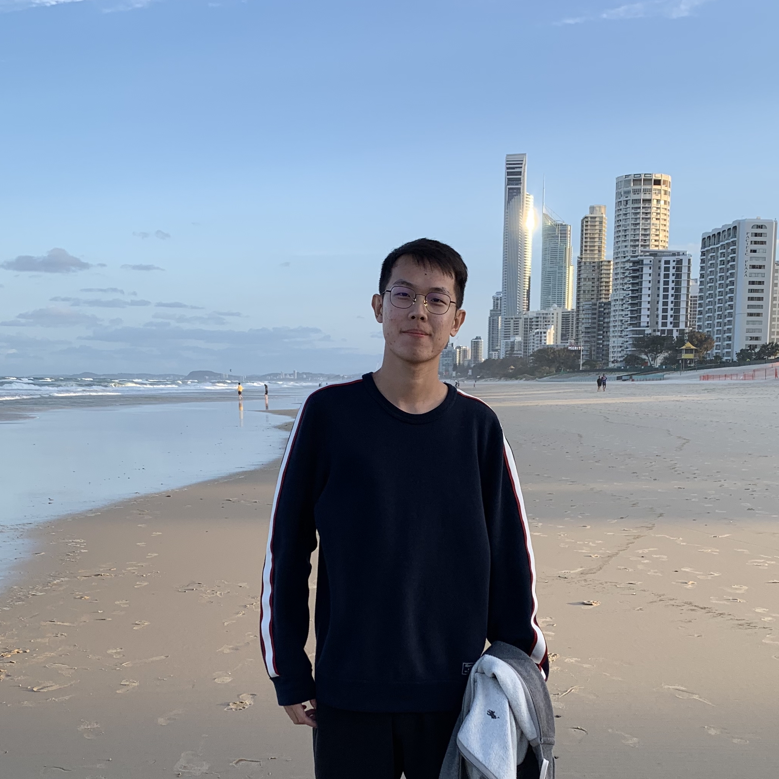


Team VIE-PKU
EndoVis 2019 Surgical Workflow and Skill Analysis
Mengqi Guo
Beihang University
Chen Gong
Peking University
Daochang Liu
Peking University
Tingting Jiang
Peking University

Slide 2
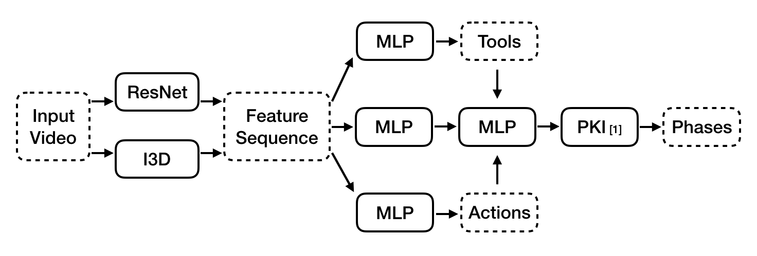
Team VIE-PKU
correlation constraints…
[1] Jin, Yueming, et al. "SV-RCNet: workflow recognition from surgical videos using recurrent convolutional network.” TMI 2017

Slide 3
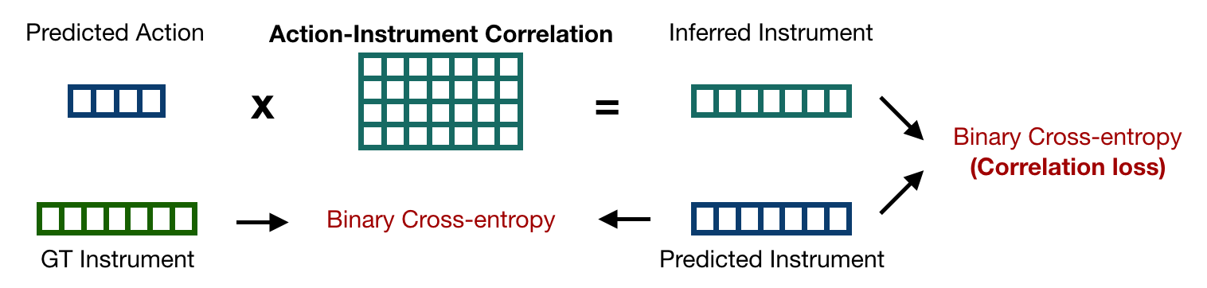
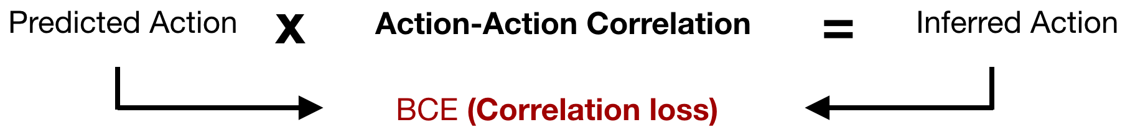
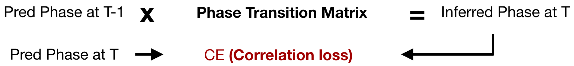
Inter-task correlation
(6)
Intra-task correlation
(2)
Phase transition correlation
(2)

